Slide 1

transmission infiltration ventilation
heating
solar irradiation
‘internal’ heat
Twomes
Results from data analysis
Henri ter Hofte, Hossein Rahmani
Research Group Energy Transition
Windesheim University of Applied Sciences
heat loss
heat gain

Slide 2
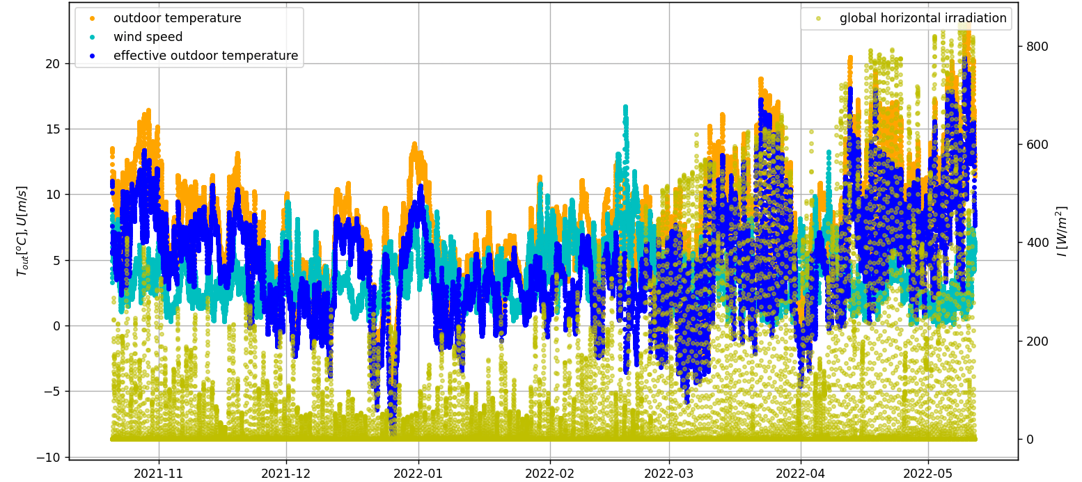
Analysis: weather in Assendorp, Zwolle
WP3: Data Analysis & Prediction

Slide 3
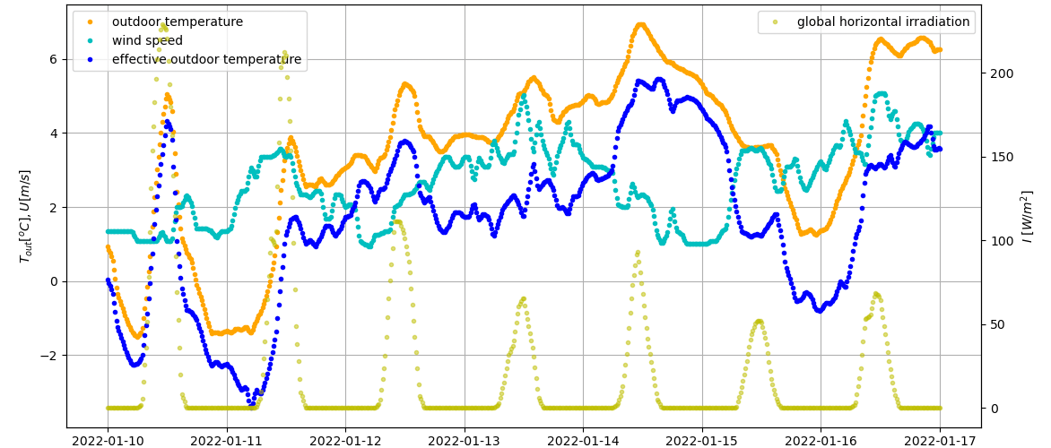
Analysis: weather in Assendorp, Zwolle
WP3: Data Analysis & Prediction

Slide 4
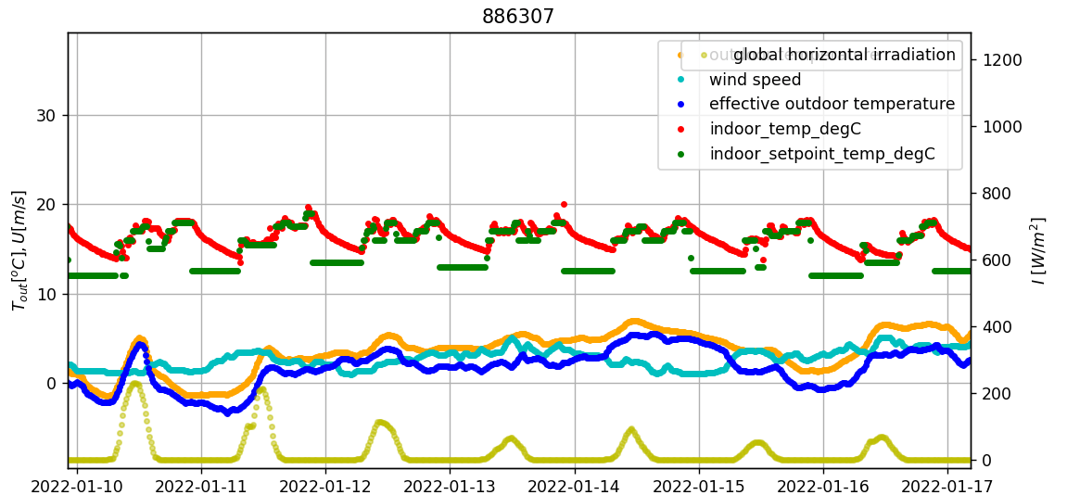
Analysis: data fora single home single week
WP3: Data Analysis & Prediction

Slide 5
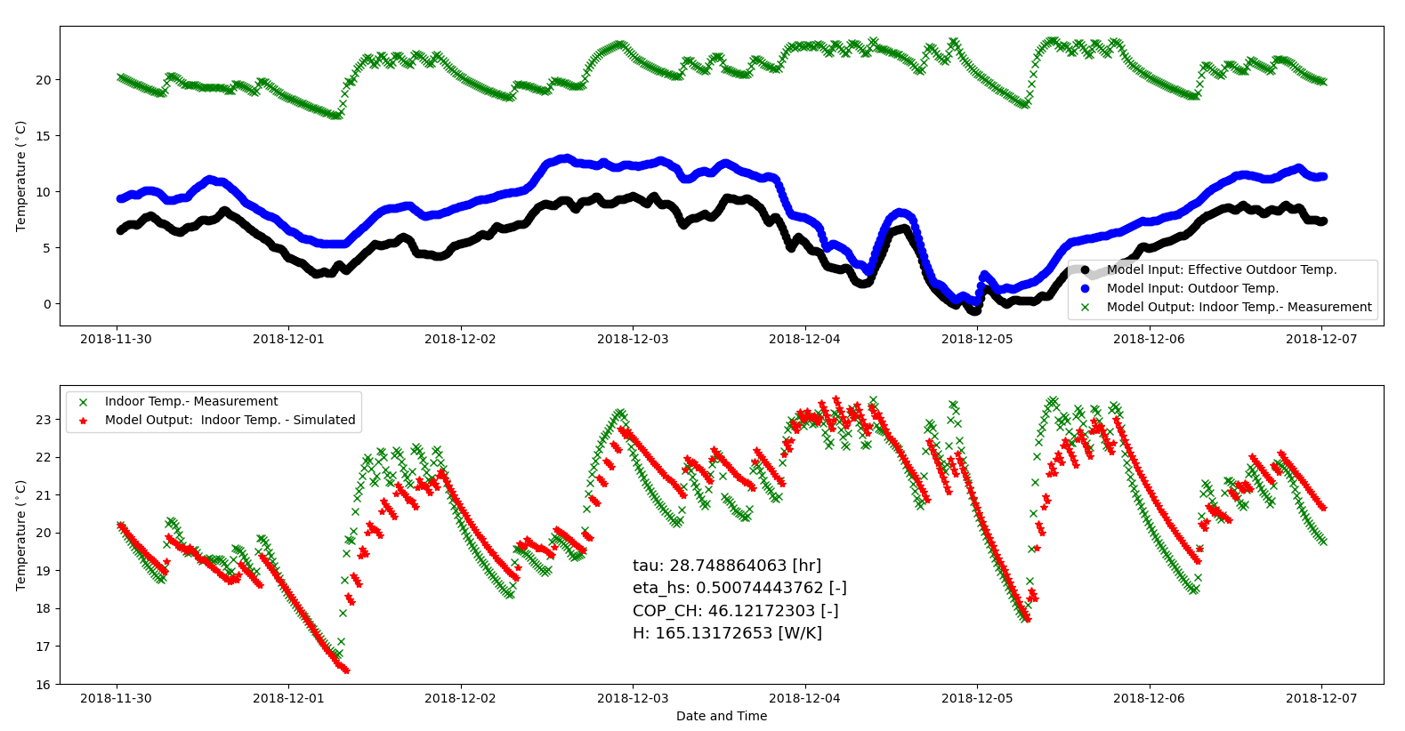
Analysis results (example; Berkum data; 1 week)
WP3: Data Analysis & Prediction

Slide 6
Model parameters we wanted to learn
Twomes WP3: Data Analysis & Prediction
symbol | scope | parameter | unit
H | building | specific heat loss | W/K
τ | building | thermal inertia | s (h)
C | building | thermal mass (C = H × τ) | J/K (Wh/K)
A | building | apparent window area (imaginary horizontal window in roof) | m²
P_{max} | installation | maximum heating system power (boiler+distribution) | W
η_{s;CH} | installation | central heating system efficiency (superior value) | %
<T_{set;h;d}> | comfort needs | weekly thermostat setpoints (home/away/asleep) | K‧s

Slide 7
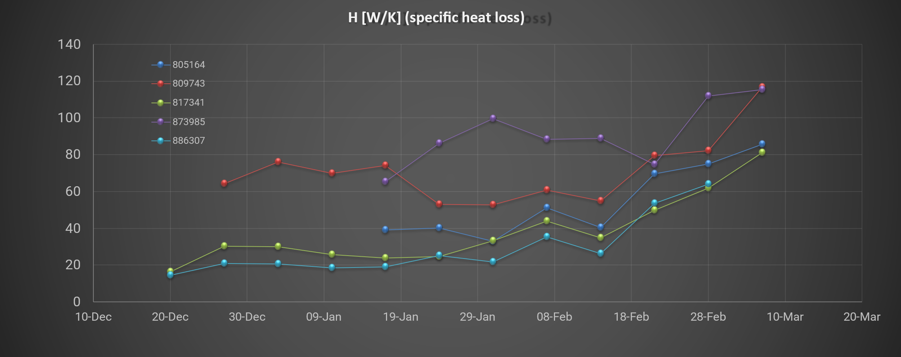
Learning H [W/K] (specific heat loss) A = 6,0 [m²] (assumed; not learnt)
WP3: Data Analysis & Prediction

Slide 8
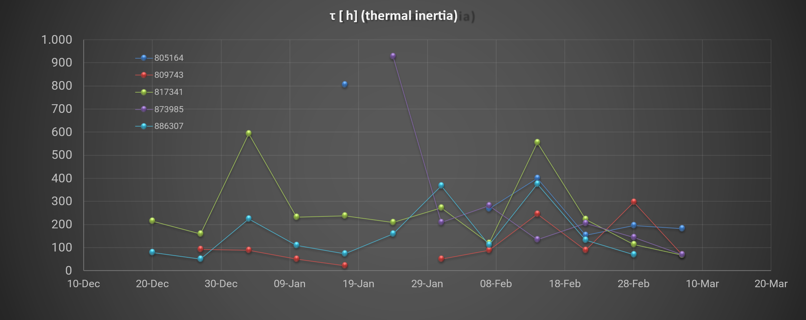
Learning τ [h] (thermal inertia) A = 6,0 [m²] (assumed; not learnt)
WP3: Data Analysis & Prediction

Slide 9
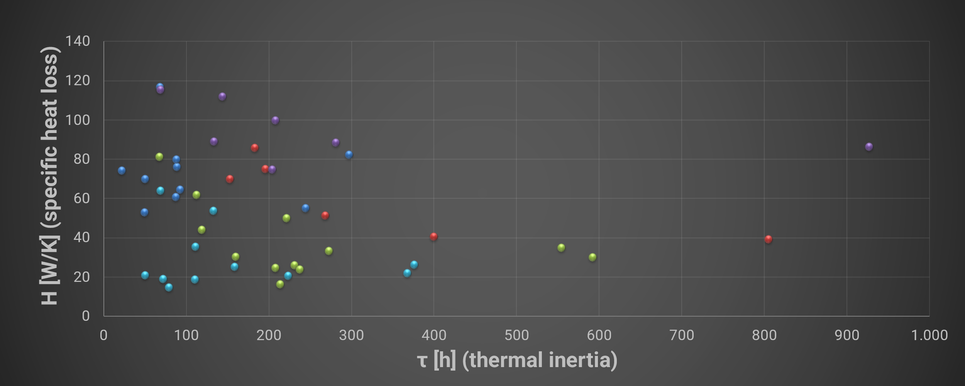
Combining H [W/K] & τ [h] each week one dot A = 6,0 [m²] (assumed; not learnt)
WP3: Data Analysis & Prediction

Slide 10
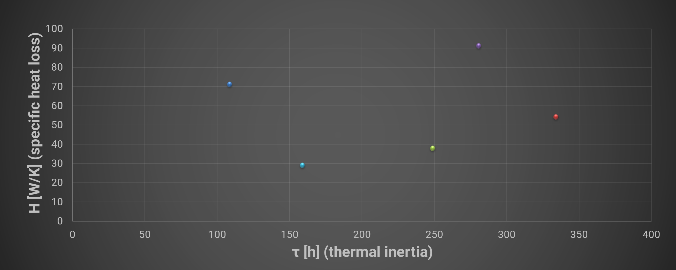
Combining H [W/K] & τ [h]; multi-week average A = 6,0 [m²] (assumed; not learnt)
WP3: Data Analysis & Prediction

Slide 11
Model parameters we wanted to learn
Twomes WP3: Data Analysis & Prediction
symbol | scope | parameter | unit
H | building | specific heat loss | W/K
τ | building | thermal inertia | s (h)
C | building | thermal mass (C = H × τ) | J/K (Wh/K)
A | building | apparent window area (imaginary horizontal window in roof) | m²
P_{max} | installation | maximum heating system power (boiler+distribution) | W
η_{s;CH} | installation | central heating system efficiency (superior value) | %
<T_{set;h;d}> | comfort needs | weekly thermostat setpoints (home/away/asleep) | K‧s

Slide 12
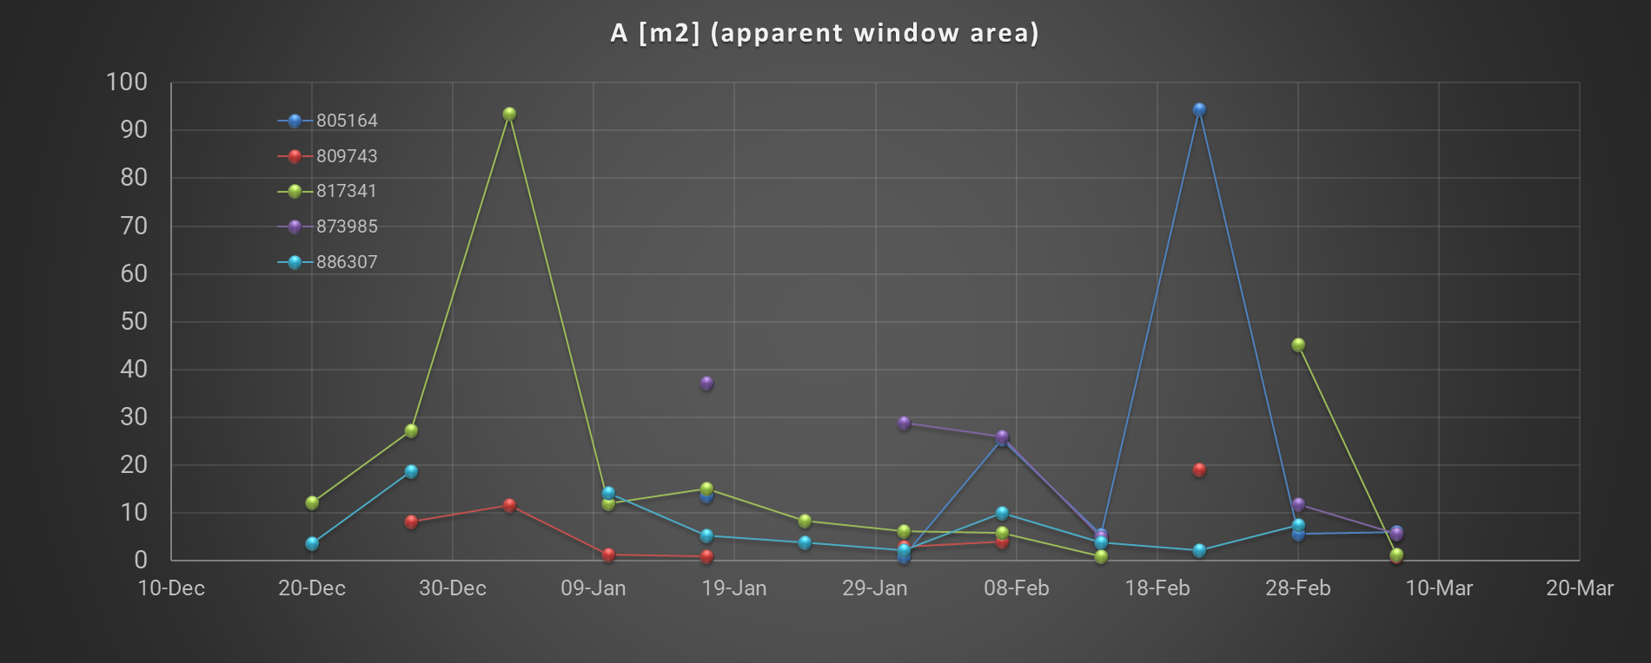
Learning A [m²] τ [h] (thermal inertia) / H [W/K] (specific heat loss) also learnt
WP3: Data Analysis & Prediction

Slide 13
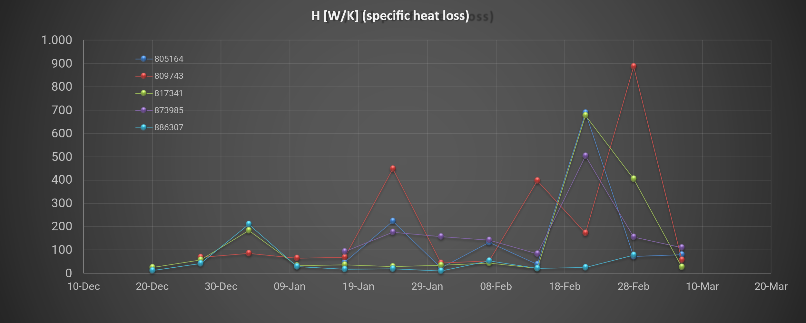
Learning H [W/K] (specific heat loss) A [m²] (apparent window area) & τ [h] (thermal inertia) / H [W/K] (specific heat loss) also learnt
WP3: Data Analysis & Prediction

Slide 14
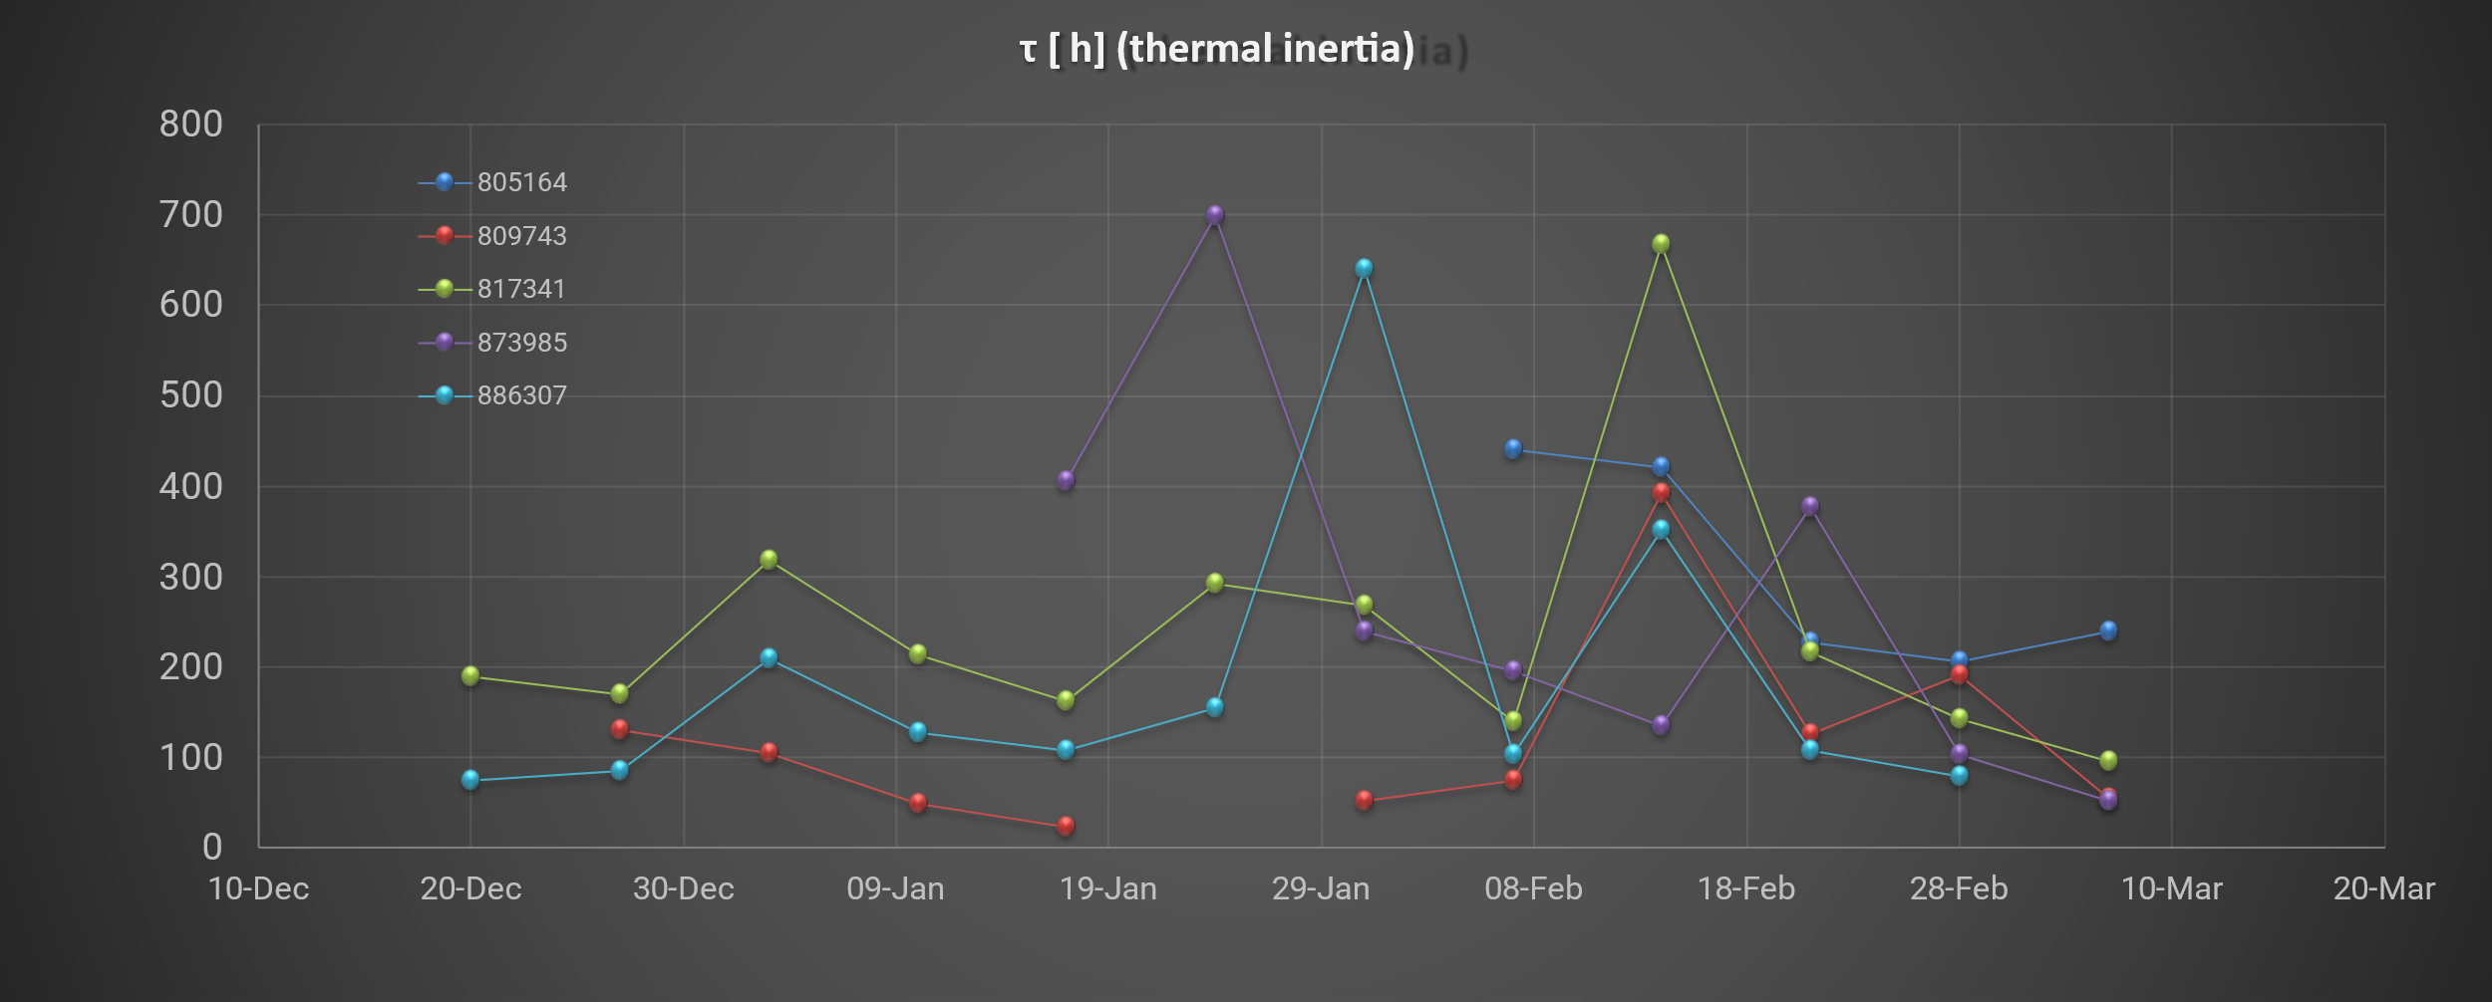
Learning τ [h] (thermal inertia) A [m²] (apparent window area) & H [W/K] (specific heat loss) also learnt
WP3: Data Analysis & Prediction

Slide 15
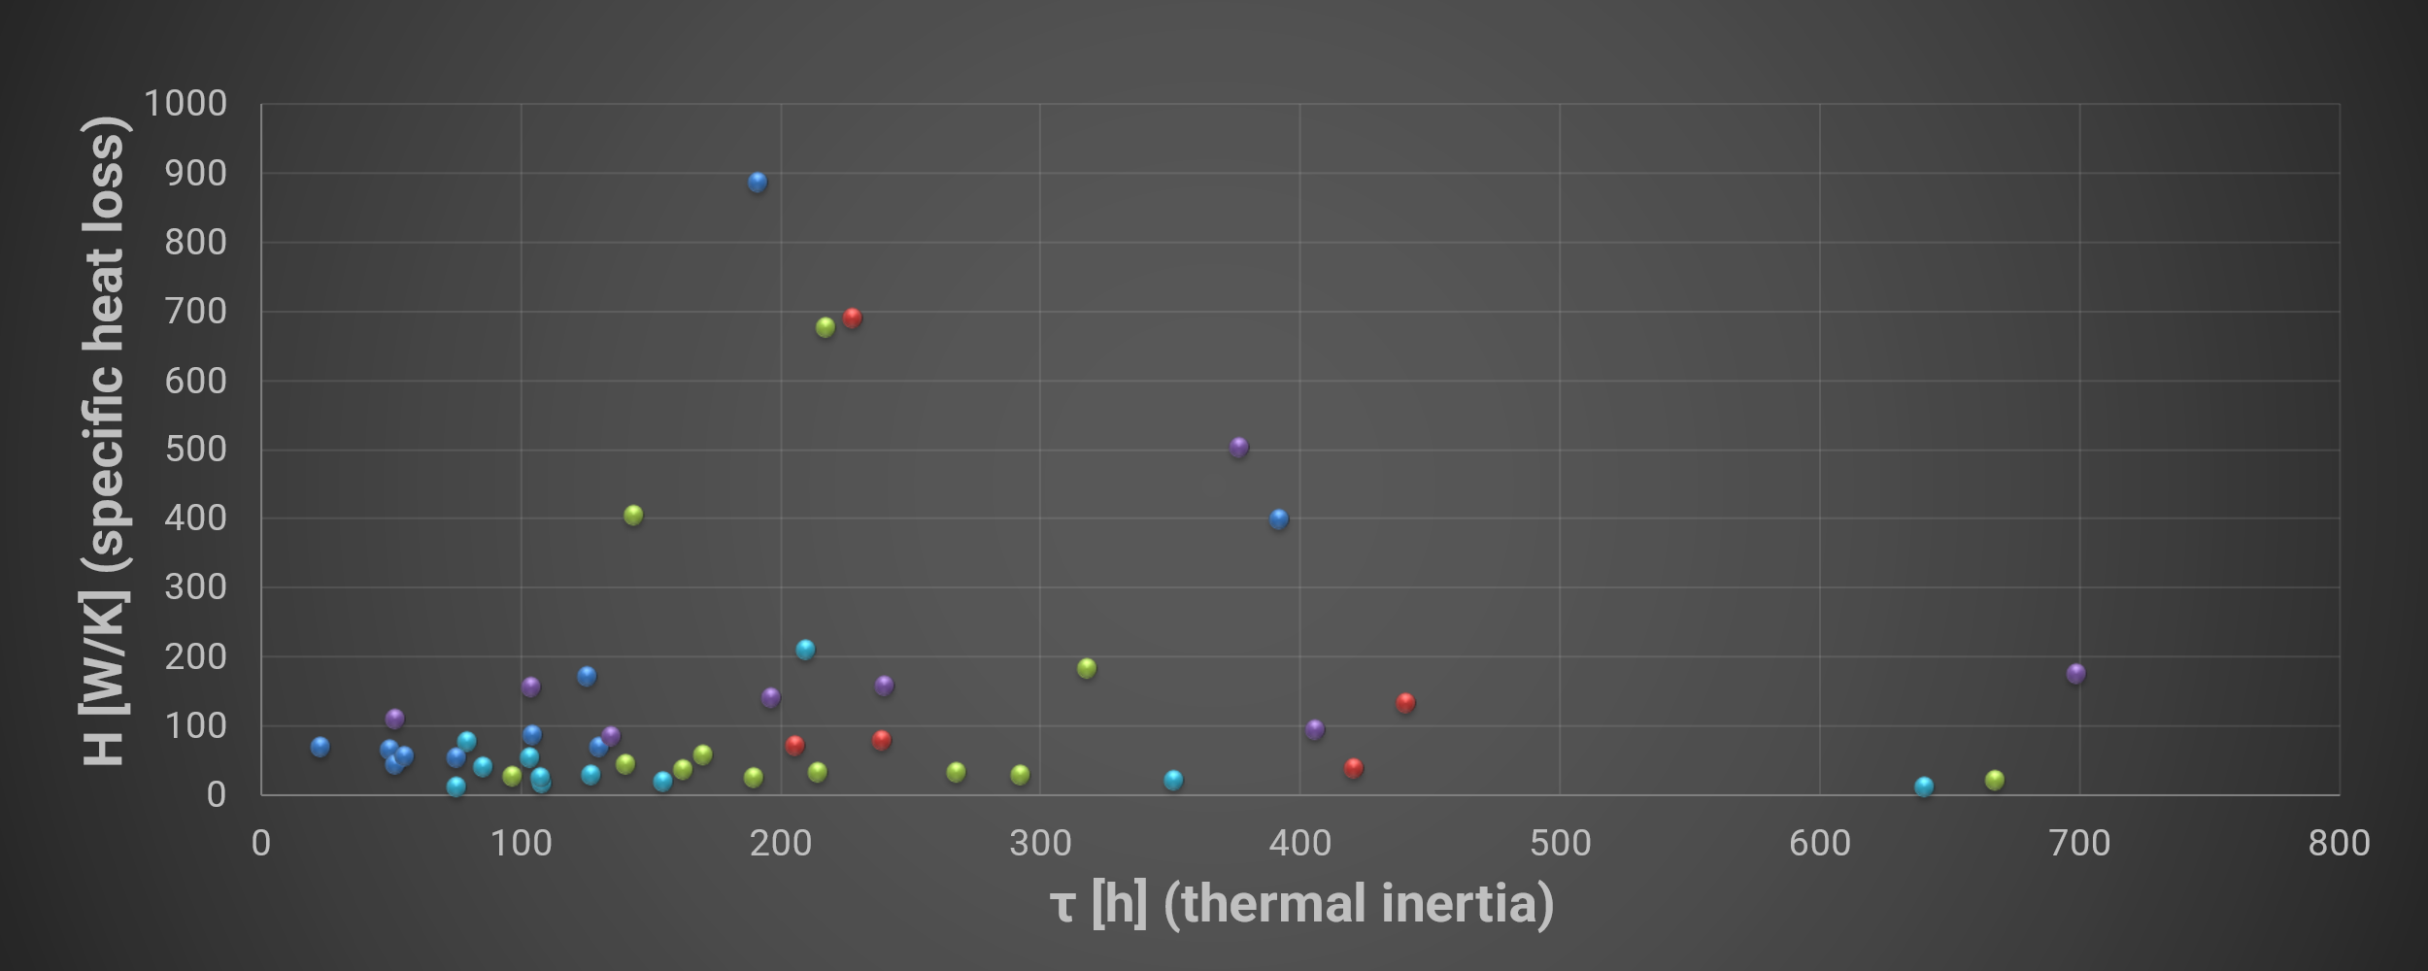
Combining H [W/K] & τ [h] each week one dot A [m²] (apparent window area) also learnt
WP3: Data Analysis & Prediction

Slide 16
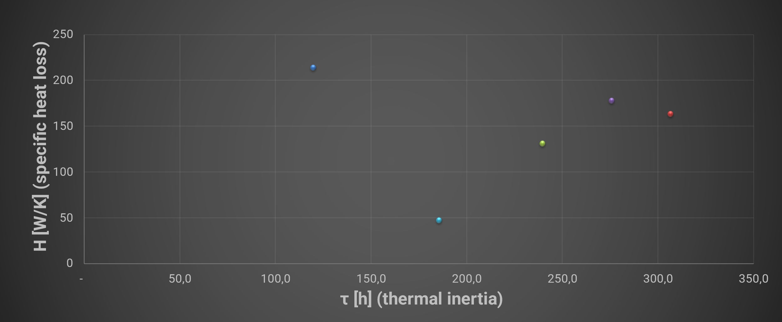
Combining H [W/K] & τ [h]; multi-week average A [m²] (apparent window area) also learnt
WP3: Data Analysis & Prediction

Slide 17
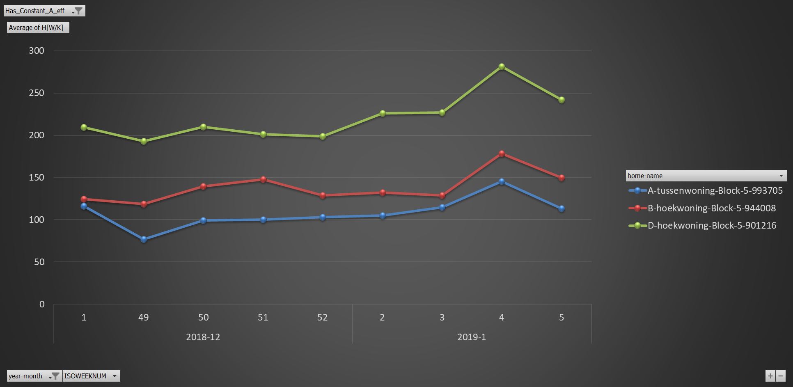
Berkum: Learning H [W/K] (specific heat loss) A = 6,0 [m²]
WP3: Data Analysis & Prediction

Slide 18
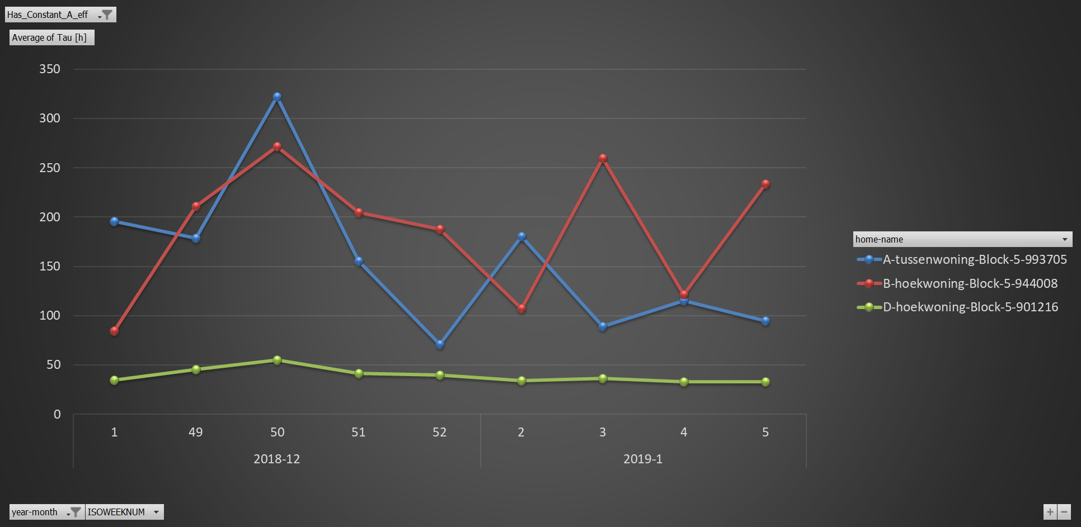
Berkum: Learning τ [h] (thermal inertia) A = 6,0 [m²]
WP3: Data Analysis & Prediction

Slide 19
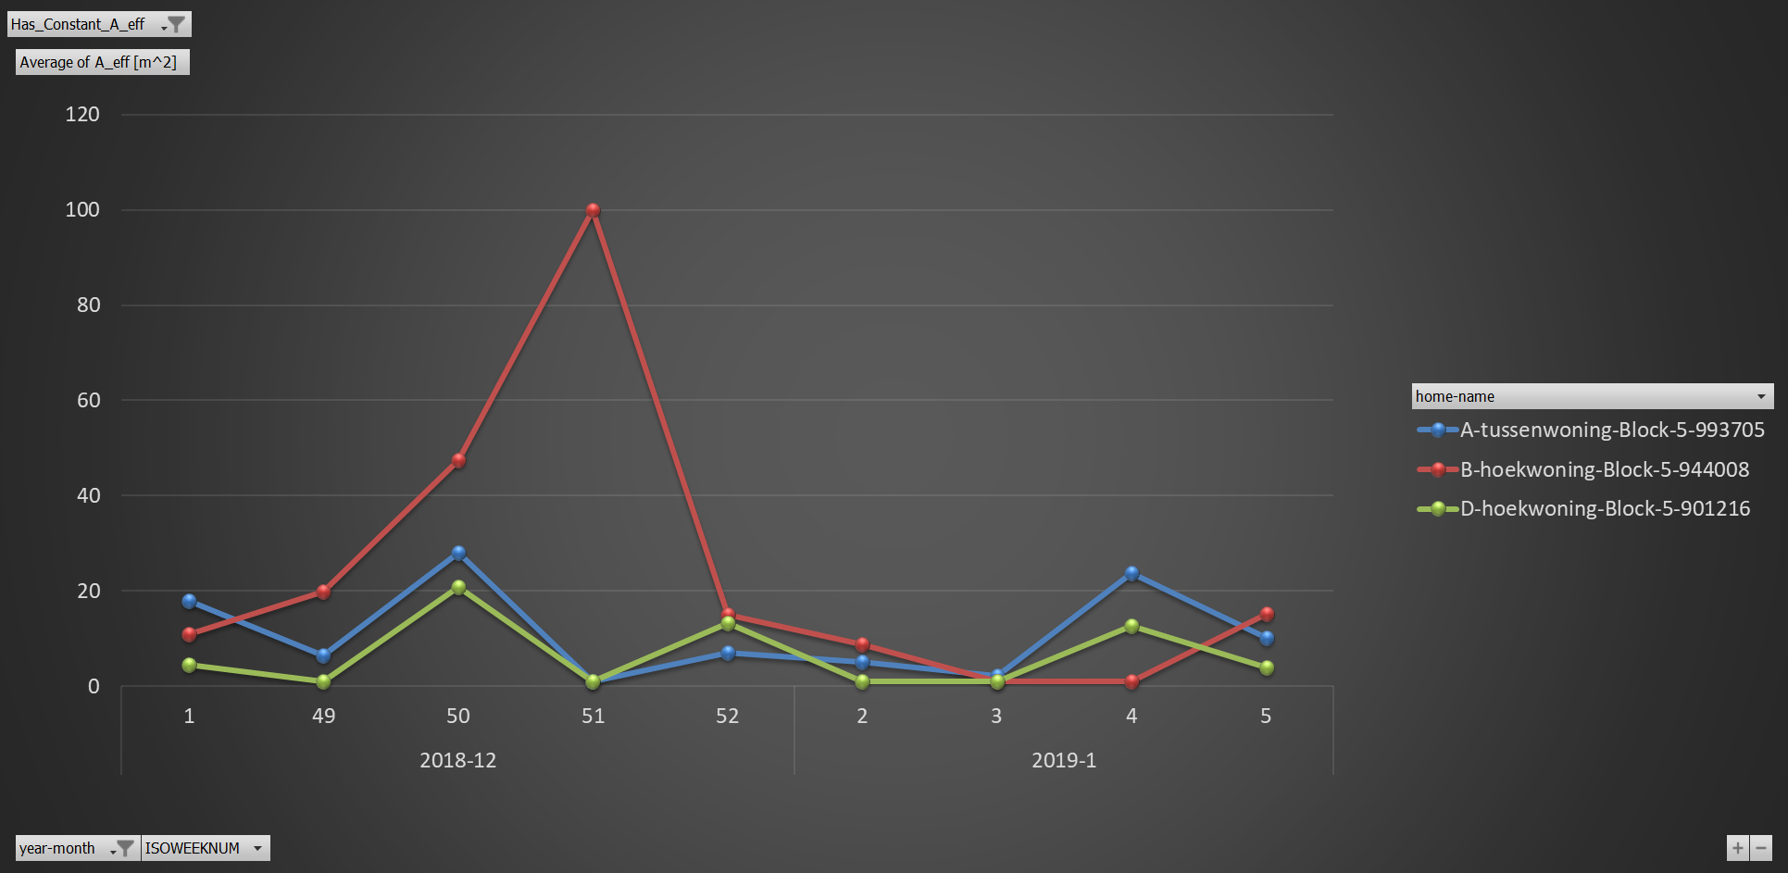
Berkum: Learning A [m²] (window aperture)
WP3: Data Analysis & Prediction

Slide 20
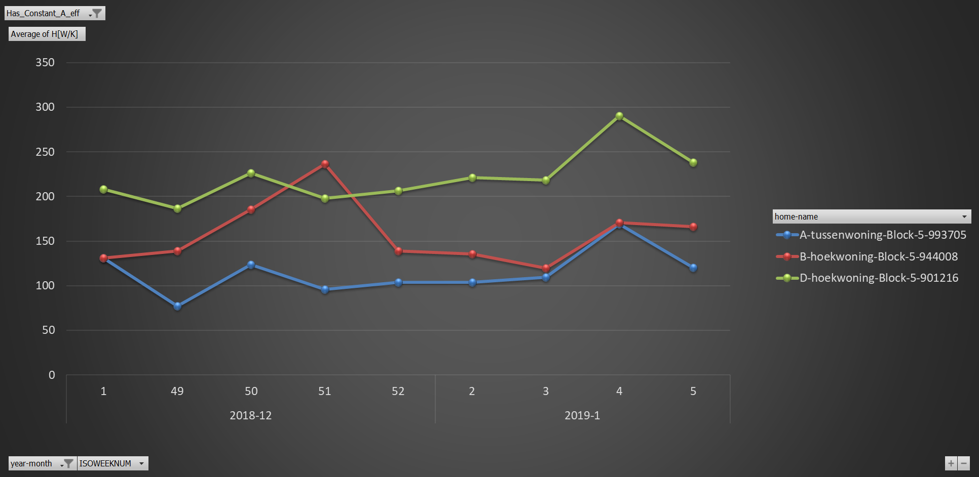
Berkum: Learning H [W/K] together with τ [h] & A [m²]
WP3: Data Analysis & Prediction

Slide 21
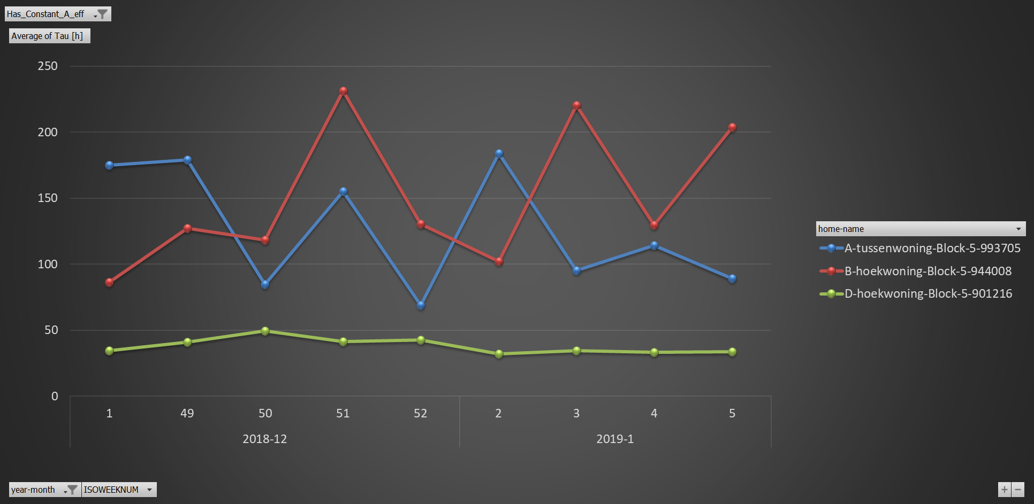
Berkum: Learning τ [h] together with H [W/K] and A [m²]
WP3: Data Analysis & Prediction

